Slide 1
Centralized Application-Context Aware Firewall
CSE7101- Capstone Project
Review-2
Batch Number: IST_33
Under the Supervision of,
Dr. Poornima S
Assistant Professor
School of Computer Science and Engineering
Presidency University
Roll Number | Student Name
20221IST0109 20221IST0100 20221IST0114 | SANJANA K HARINI K HEGDE SNEHA S
Name of the Program: Information Science and Technology
Name of the HoD: Dr. Pallavi R
Name of the Program Project Coordinator: Ms. Benitha Christinal J , Assistant Professor(SoCSE)
Name of the School Project Coordinators: Dr. Sampath A K , Dr. Geetha A

Slide 2
Problem Statement Number: PSCS_365
Problem Description:
Develop a context-aware application firewall for endpoints that can identify and control each application’s access to external networks. The firewall will allow granular restrictions on domains, IPs, and protocols, managed via a centralized web console. An endpoint agent will enforce policies, log application network usage, and send data to the central server. Using AI/ML, the system will detect abnormal traffic behavior and generate alerts.

Slide 3
Content.
Abstract
Literature survey
objectives
Existing methods and drawbacks
Innovation or Novel Contributions
Proposed method and feasibility study
Architecture Diagram
Modules
Hardware and software detail
Timeline
References

Slide 4
Abstract
A context-aware application firewall for endpoints intelligently identifies and controls each software application's network access, allowing fine-grained restrictions on domains, IPs, and protocols. Central policy management via a web console enables scalable administration across large networks. AI/ML-driven anomaly detection monitors application traffic to spot abnormal usage patterns and trigger alerting, enhancing security beyond traditional rule-based approaches.

Slide 5
Literature survey
AI-Driven Dynamic Firewall Optimization Using Reinforcement Learning for Anomaly Detection and Prevention
Adaptive Cybersecurity: Dynamically Retrainable Firewalls for Real-Time Network Protection
Analysis of Web Application Firewalls, Challenges, and Research Opportunities
Web application firewall based on machine learning models
Beyond Firewall: Leveraging Machine Learning for Real-Time Insider Threats Identification and User Profiling
Dynamic AI-Augmented Firewall for Real-Time Threat Mitigation
Centralized Application-Context Aware Firewall
A Comprehensive Survey of ML-Based WAFs with Signature and Anomaly Detection
AI Based Anomaly Detection in Endpoint Logs
Machine Learning and AI in Endpoint Security: Analyzing Use of AI/ML Algorithms for Anomaly Detection and Threat Prediction in Endpoint Security

Slide 6
Objectives.
Develop a context-aware firewall agent that can monitor and control application-level network access on endpoints.
Provide granular access control by restricting applications based on domains, IP addresses, and protocols.
Design a centralized web console to manage firewall policies, endpoints, and applications from a single interface.
Collect and analyze per-application network usage logs for better visibility and decision-making.
Implement AI/ML-based anomaly detection to identify abnormal traffic patterns and generate alerts.
Ensure compatibility with Windows endpoints (with optional Linux support).
Enable scalability and ease of deployment for use in enterprise environments.

Slide 7
Existing Methods and Drawbacks
Traditional endpoint firewalls rely mainly on IP/port filtering, lacking context about application behavior.
Intrusion Detection Systems (IDS) focus on signature-based attack detection, not traffic anomalies in application usage.
Existing solutions struggle with complexity, performance impact, and poor visibility into per-application traffic.
Management of distributed firewall policies is complex and often not centralized for endpoints.
No support for AI/ML-based adaptive anomaly detection in most commercial endpoint firewalls—leading to missed sophisticated threats.

Slide 8
Proposed Method and Feasibility study
Endpoint agents intercept and analyze outbound network calls for each application, enforcing real-time policies.
Central server aggregates logs from agents, enabling administrators to manage, audit, and update firewall rules through a web console.
AI/ML models process network telemetry to detect anomalies; alerts are generated and routed back to both user and administrator dashboards for quick action.
Feasibility rests on proven hybrid LSTM-CNN models for anomaly detection and mature systems for centralized firewall rule management.
Scalability and cross-platform architecture align with the needs of modern organizations.

Slide 9
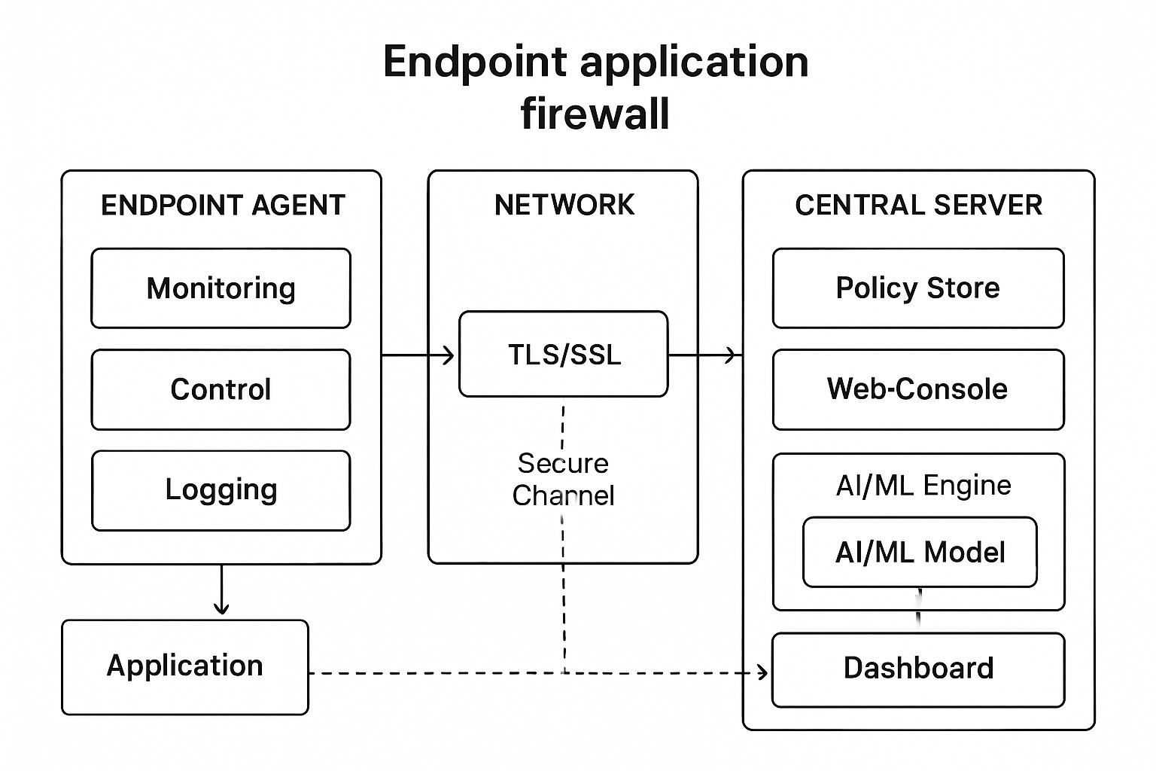
Architecture

Slide 10
Hardware and Software detail
Endpoint: Windows/Linux OS, minimum dual-core CPU, 2GB RAM, agent software (C++/Go/Python).
Central Server: x86 server/VPS, minimum 4-core CPU, 8GB RAM, PostgreSQL/MySQL DB, TensorFlow/PyTorch (AI), web stack (React/Angular + Node.js/Flask).
Secure communication: TLS/SSL.
Redundant server hardware and network connectivity recommended for HA.
Compatible with existing enterprise identity providers (LDAP, SSO).

Slide 11
References (IEEE Paper format)
[1] K. Singh and S. Silakari, “A survey of cyber-attack detection systems using machine learning,” International Journal of Computer Applications, vol. 45, no. 17, pp. 25–32, May 2021.
[2] Palo Alto Networks, “Next-Generation Firewall (NGFW) Overview,” Palo Alto Networks, 2023. [Online]. Available: https://www.paloaltonetworks.com/network-security
[3] Z. Noor, S. Hina, F. Hayat, and G. A. Shah, “An intelligent context-aware threat detection and response model for smart cyber-physical systems,” Internet of Things, vol. 23, p. 100843, 2023.
[4] Noor, Z. et al. "An intelligent context-aware threat detection and response system." (2023). ScienceDirect (Cites IEEE approaches in system design and implementation for context-aware security, likely relevant for architecture, although direct IEEE publication or citation may be needed)
[5]A. Rathore, N. Chaudhary, K. Jangid, N. Hooda, and S. Sharma, "Centralized Application-Context Aware Firewall," Pratibodh, vol. 12, no. 2, pp. 15–24, Jun. 2025.
[6]P. Mandru, "Machine Learning-Based Anomaly Detection in NFV: Security Challenges," Computers, Materials & Continua, vol. 77, no. 2, pp. 1751–1768, Jun. 2023.
[7]Z. Liu, L. Sun, B. Chen, and T. Li, "Deep Learning-based Anomaly Detection and Log Analysis for Computer Networks," Journal of Information and Computing, vol. 2, no. 2, pp. 34–63, 2024.

Slide 12
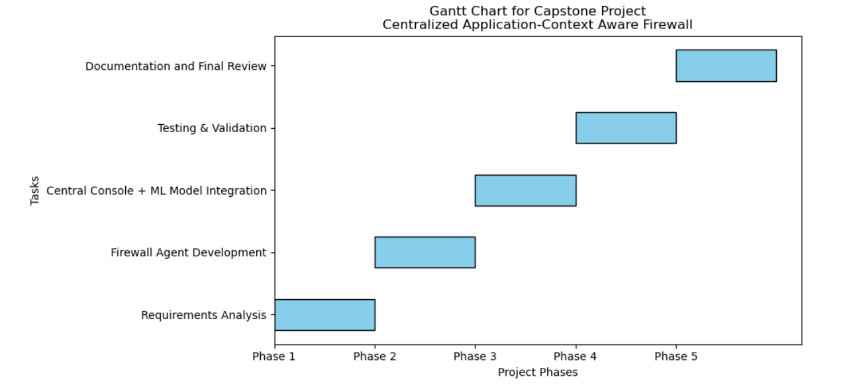
Timeline of the Project (Gantt Chart)

Slide 13


